Slide 1



E-commerce Website
E-MART
Guided By:-Prof Ronak N. Patel
Prof Martin Parmar
Prepared By:-Nishar Khorajiya-21CE057
Joisar Sujal-21CE046

Slide 2
Overview:-
Project Definition
Project Description
Objective
Major Functionalities
Technologies used in projects
Requirements
Future Work
Snap of Website
References

Slide 3
Project definition
It is a E-commerce website for Ordering Products Online.
All can Order any Products at Good Price and Best Quality

Slide 4
Project Description:-
The primary goal of an e-commerce site is to sell goods online.
This project deals with developing an e-commerce website for Online Product Sale. It provides the user with a catalog of different product available for purchase in the store.
In order to facilitate online purchase a shopping cart is provided to the user.
Also if the User wants to add his own Item then he/she can add his Item and Earn Profit from it.
So Basically it is “Refer and Earn” Website.

Slide 5
Objective
The Moto Behind this website is that Any person can buy anything from mini product to large product very easily at best price and good quality .
Also if the user wants to add his own item then it can be easily added and can earn from it.
Also it is User-friendly Website.

Slide 6
Major Functionalities:-
Register
Login
Select Any items from Given Products.
Add to Cart
Bill Page.
About us.
Contact us.

Slide 7
Technologies used in Project:-
Frontend:-
Html(5)
CSS(4)
JavaScript(18.2.0)
BOOTSTRAP(5)
Backend:-
MongoDB(6.0.)
Nodejs(18.0.0)

Slide 8
Requirements
Software
Vs Code
Chrome Search Engine
Hardware
Processor : intel core i5
Memory(ram) : 8GB

Slide 9
Future Work
The Users who want to sell their products through our website they can sell it and gain profit from us.
Payment Gateway
Search Functionality

Slide 10

Home Page

Slide 11
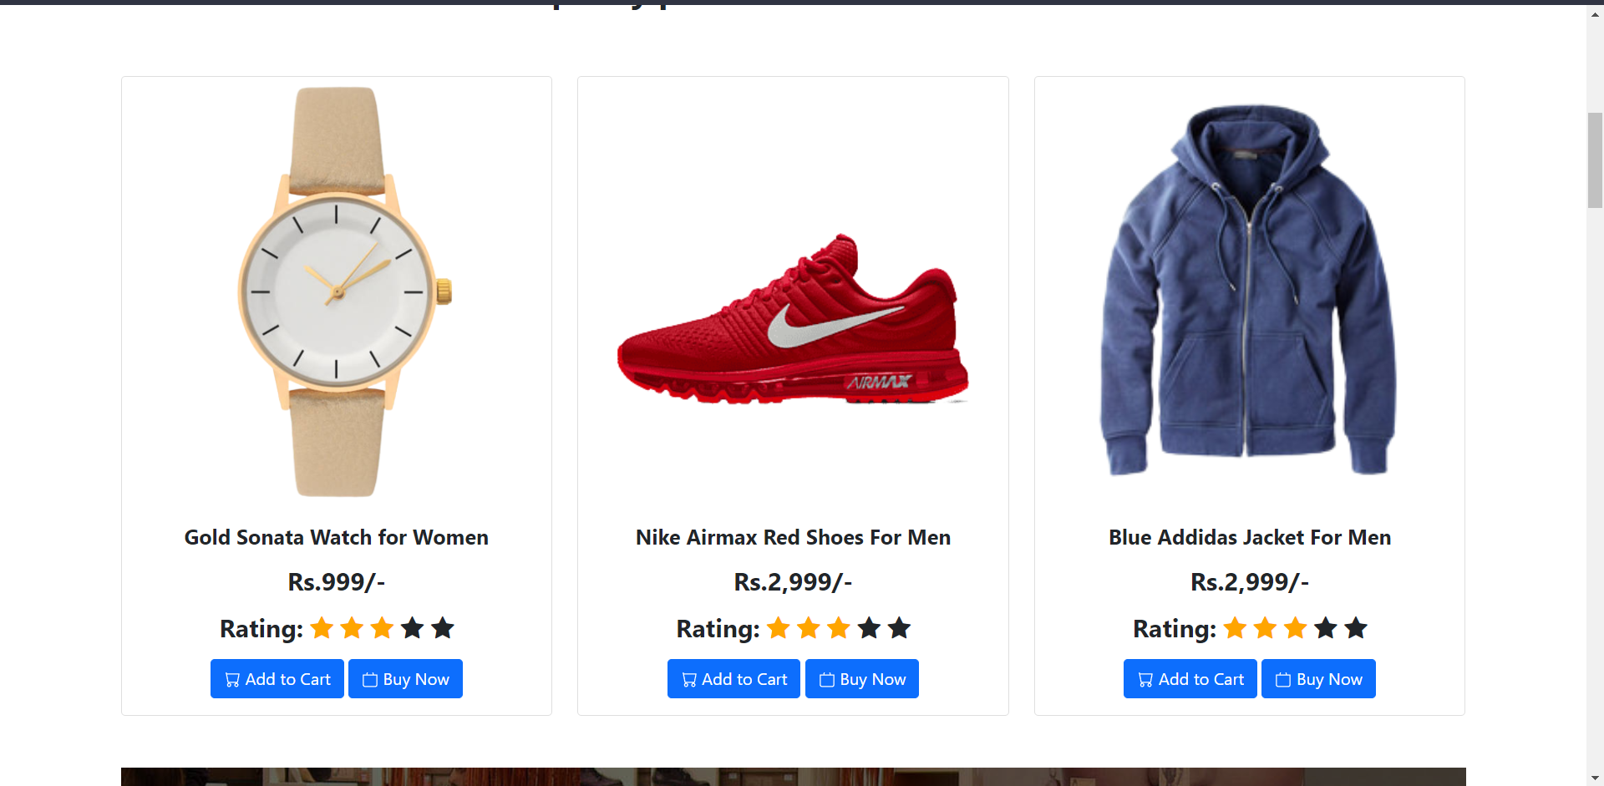
Home Page

Slide 12
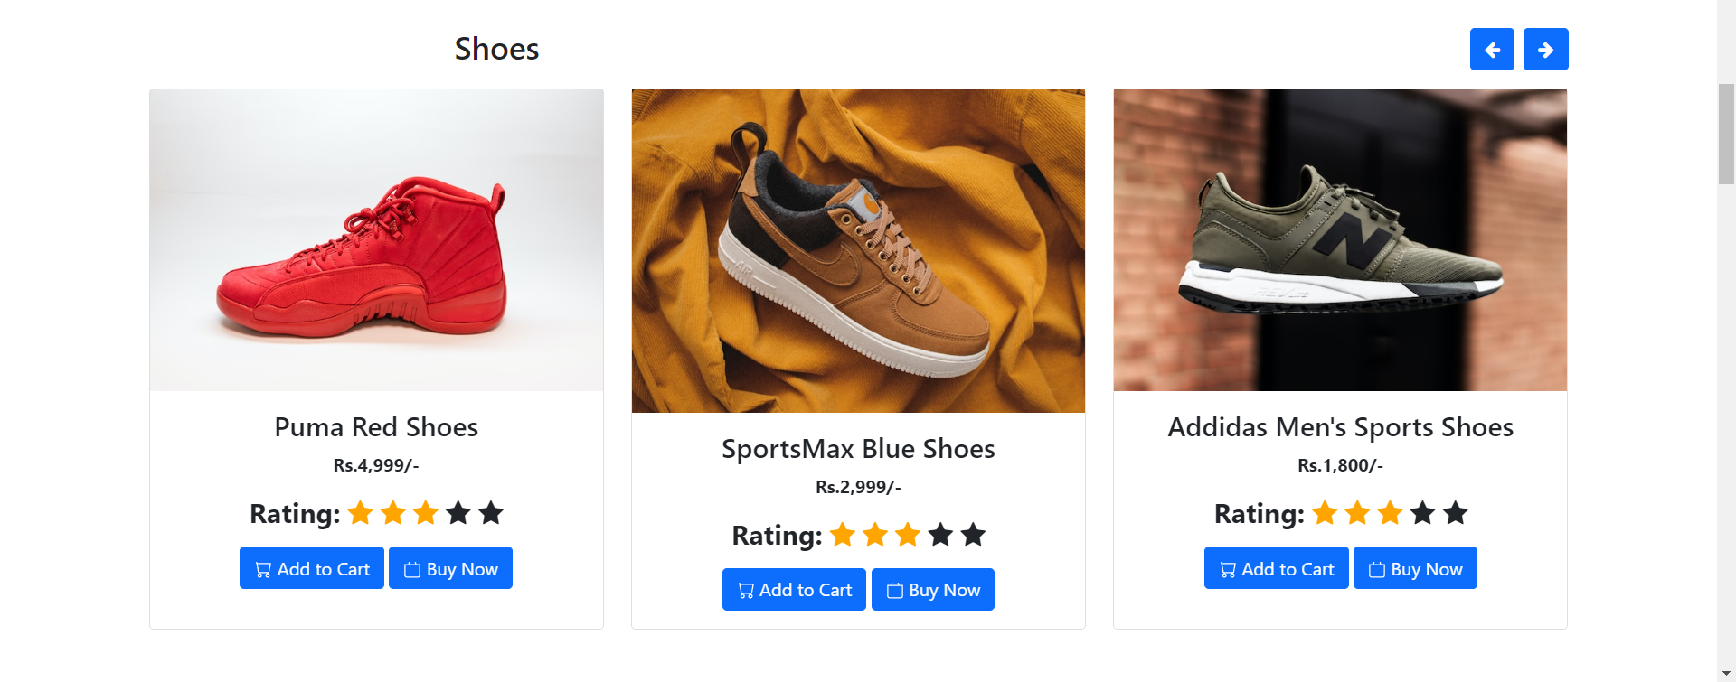
Home Page

Slide 13
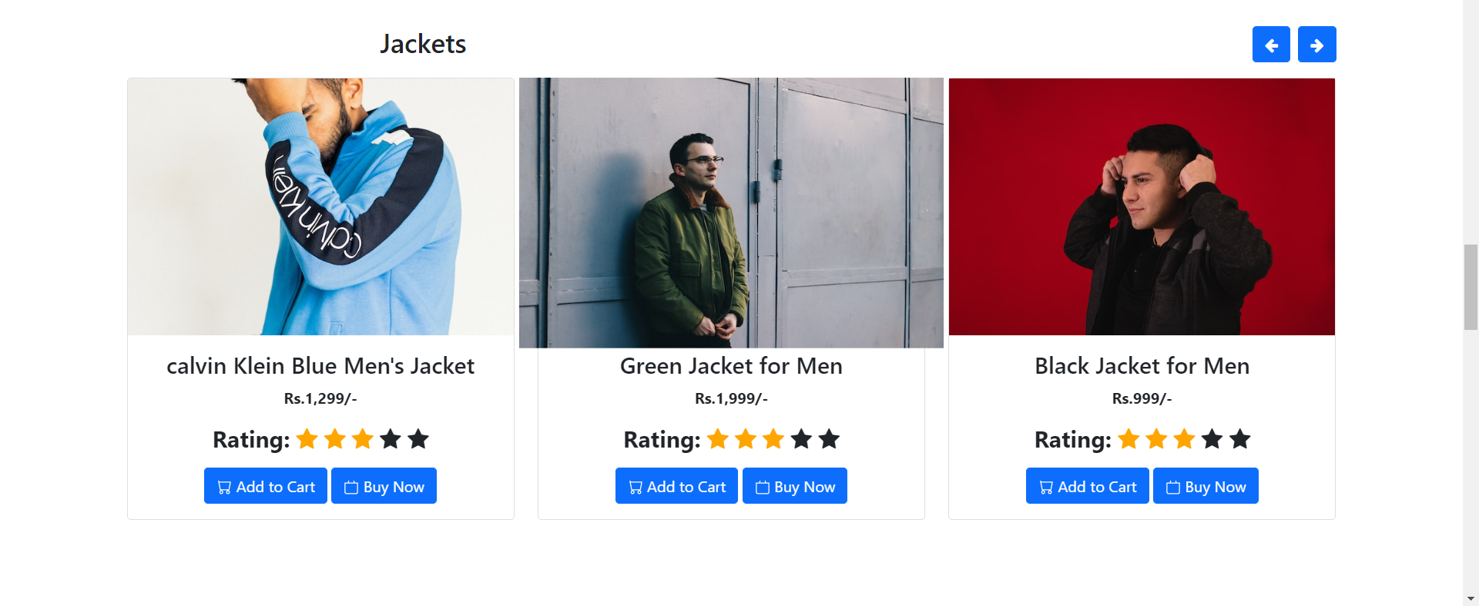
Home Page

Slide 14
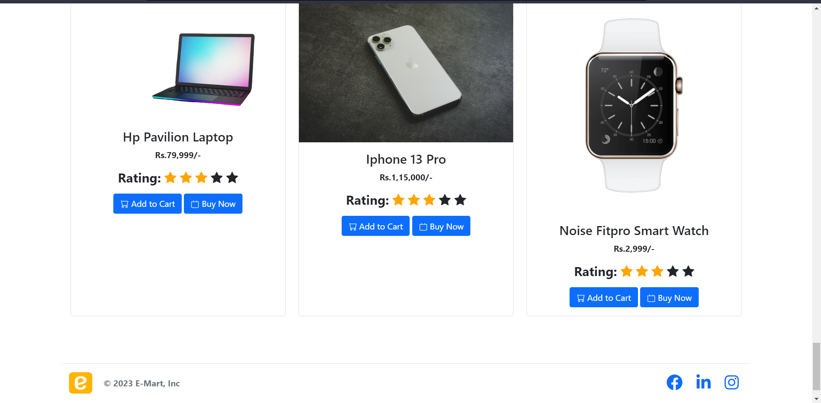
Home Page

Slide 15
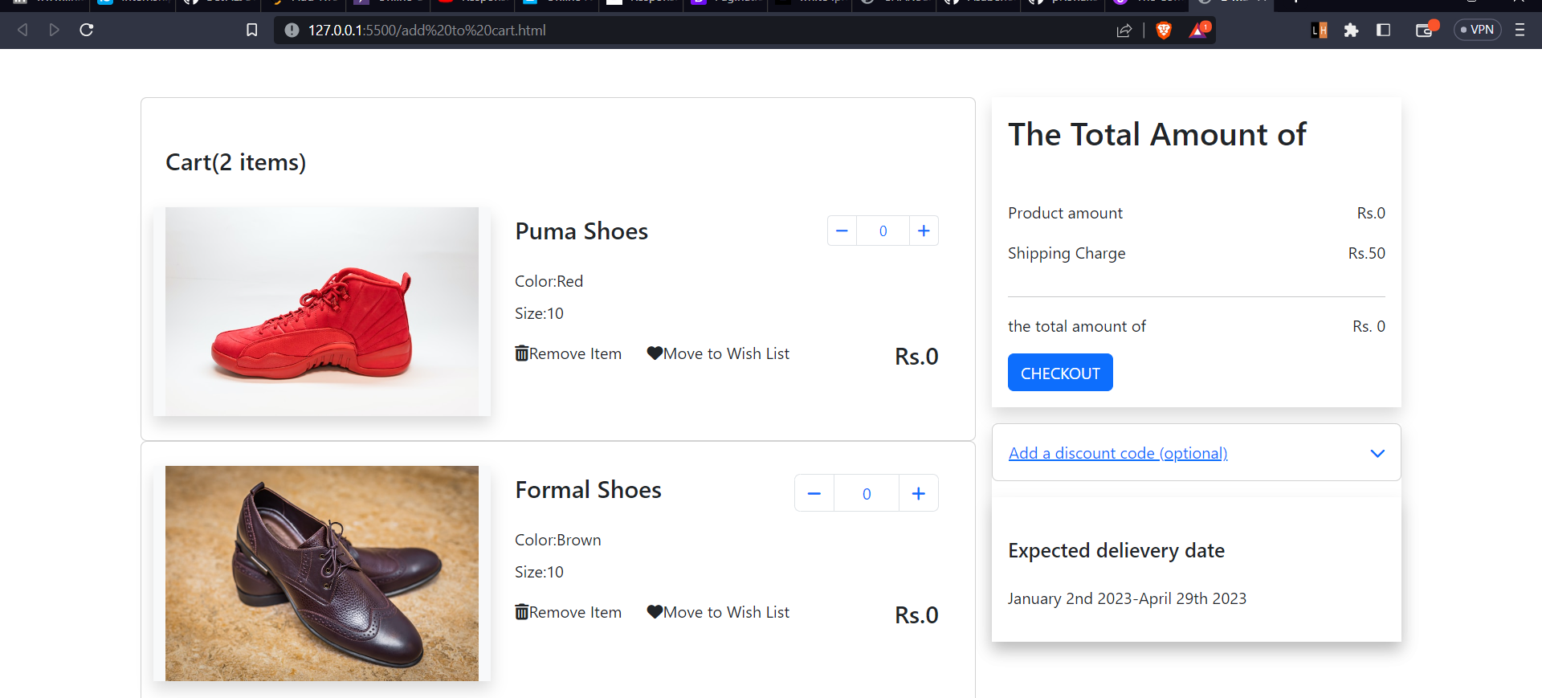
Add to Cart

Slide 16

Login

Slide 17

Signup

Slide 18
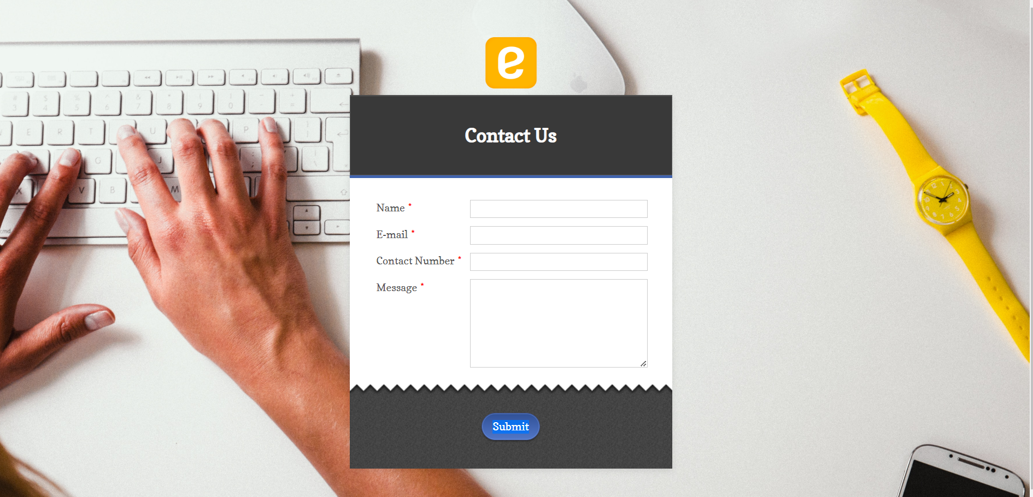
Contact Us

Slide 19
Reference
https://www.youtube.com/watch?v=yfpoT0YKSIc
https://www.youtube.com/watch?v=2DUJvbw6jTA

Slide 20
THANK-YOU

